Slide 1




Commit Bubbles
@barik
Titus Barik Kevin Lubick Emerson Murphy-Hill
Notes:
Name. Some early insights through an experience called Commit Bubbles, that will make version control a more friendly experience for developers.

Slide 2


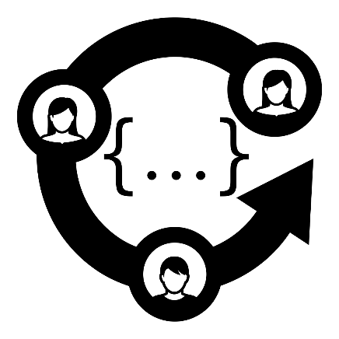

Version Control Systems
Notes:
Version control systems, such as git, are of course important because the store your source code, but they are also important in that they play a central role in many development activities, such as a code reviews, preparing releases, or patching software.

Slide 3
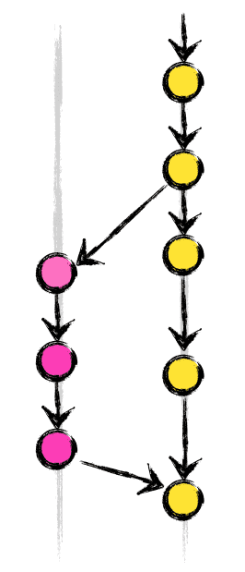
Version Control Systems
Commit: An atomic set of changes with respect to a previous state.
Sequences of commits form a commit history.
History revision allows you to rearrange commits (e.g. squash).
Notes:
In this talk, there are just a few concepts you need to know
Commit – yellow and purple
Commit history – property that we exploit

Slide 4

Theory (Best Practices)
“To my mind, half the reason to have code reviews and continuous integration is to make sure that the project history is coherent and bisectable.” (HN poster, 2014)
“Each commit should have a single purpose and should completely implement that purpose … the utility of the version control history is compromised if one commit contains code that serves multiple purposes.” (Ernst, 2014)
Notes:
Because of the central role that they play in external activities… researchers and software engineers
Hn find many quotes respresentative. ICSE yesterday saw some quotes

Slide 5

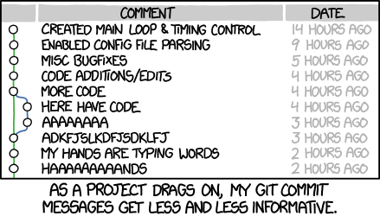
Reality
“Personally, I commit early and often and then let the sausage making be seen by all except in the most formal of circumstances.” (Robertson, 2012)
Notes:
The reality is that these best practices are easier said than done, despite our good intentions. Xkcd accurately depicts, commit messages are cognitively demanding.

Slide 6

Incomplete and Tangled Commits
Commit messages are incomplete or incorrect.
Make merges difficult, and hinder effective code reviews.
(Kirinuki, 2014)
Notes:
Fail to capture the full description of the change.
These tangled commits, or commits with multiple purposes

Slide 7

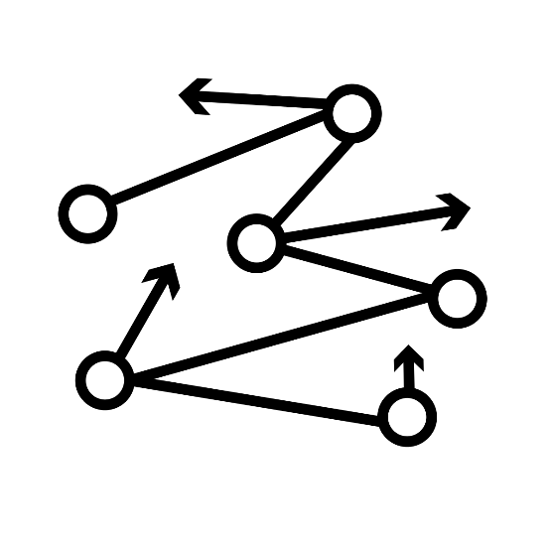


Insight: Conflicting Expectations
Systematic
As-Needed
Notes:
Conflicting expectations today between how tools expect developers to work, and how developers actually work…. And we see this conflict materialize in the domain of version control
Specifically… work systematically, but as-needed.

Slide 8
Evidence of Incompatibility
Refactoring operations are performed frequently, but interleaved with other types of programming activity (Murphy-Hill, 2012).
46% of refactored program entities are interspersed with other changes (Negara, 2012).
20%-60% of commits intersperse peripheral changes, such as code formatting (Kusunoki, 2013).

Slide 9
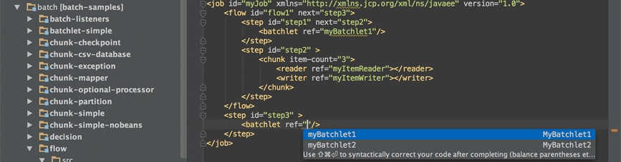
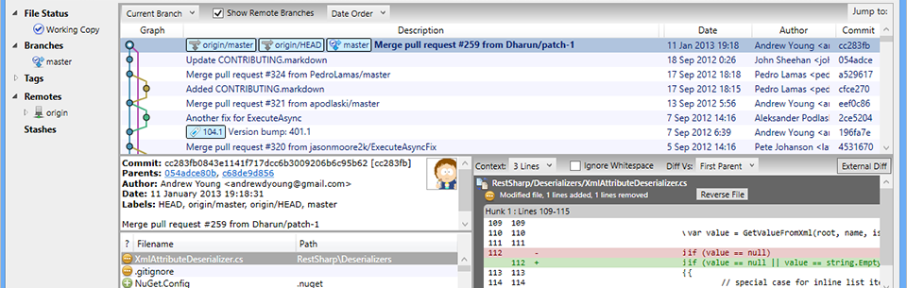
First Problem: Context Switching
Revision activities are typically performed as a distinct activity from coding.
Notes:
To understand this misalign, we talk about some insights, informal study which can be found in the paper.
But essentially, We identified two problems that make it difficult for developers to work in this as-needed way and yet generate systematic histories… version control systems can’t take advantage of interactions

Slide 10
Second Problem: Revision is Exceptional
History revision takes the perspective that developers are ordinarily able to create successful systematic histories.
“Exceptions are normal in work processes. It has been found that much of the office work is handling exception situations.” (Ackerman, 2000)
Notes:
Developers are basically perfect, and only make mistakes rarely.

Slide 11
Our Vision
Allow developers to work as-needed, but create histories that are systematic.
First Problem: Context Switching
Approach: Blend coding and commit activities to minimize context switching.
Second Problem: Revision is Exceptional
Approach: Treat history revision as routine, rather than exceptional.
Notes:
Allow developers to work as-needed, but create histories that are systematic.

Slide 12

Let’s Talk About Commit Bubbles
Notes:
What I’d like to do now is take this vision and conceptualize it through a set of a mockups.
So this isn’t a real implementation, but hopefully with the mockups and some imagination get an intuition about the developer interactions within this system.

Slide 13
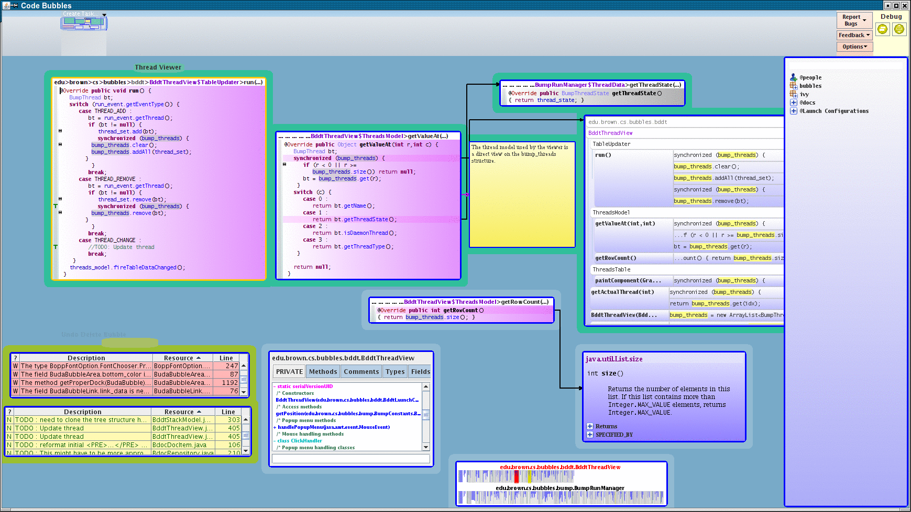
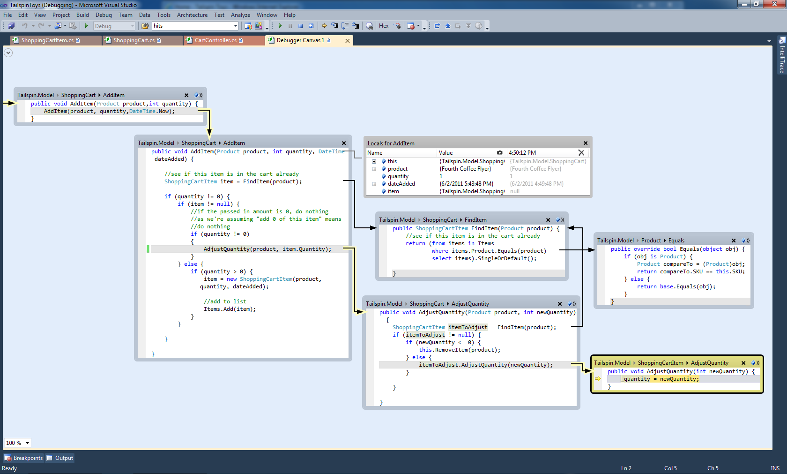
Fragment-oriented IDEs
Code Bubbles (Bragdon, 2010)
Debugger Canvas (DeLine, 2012)
Notes:
To us, Version control appears to be an inherently fragment-oriented activity,
In which we typically reason about small chunks of code at a time. For example, comparing diffs requires that we look at fragments of code. Recording a commit is a fragment oriented activity.
Looking at the literature… we found approaches such as code bubbles and debugger that bake in support for fragment-oriented thinking, and might be good for reducing disorientation and minimizing context switching

Slide 14
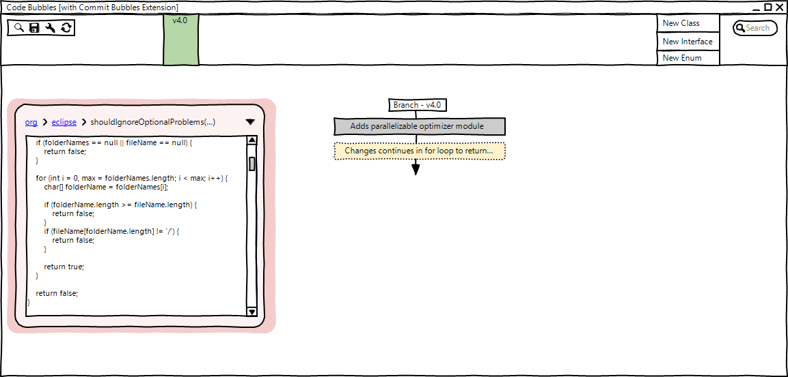
Commit Bubbles User Story
1
3
2
Notes:
Like the previous tools, our approach takes the code bubbles metaphor extends it to version control.
Story time
So imagine that I’m a software developer
And I need to make a modification to Eclipse, because of an issue with paths.
Through the Context…. Latest version …. 4.0 …. Preview pane
Code bubbles… load a method ….
In this extension, Not just code… bubbles can be branches

Slide 15
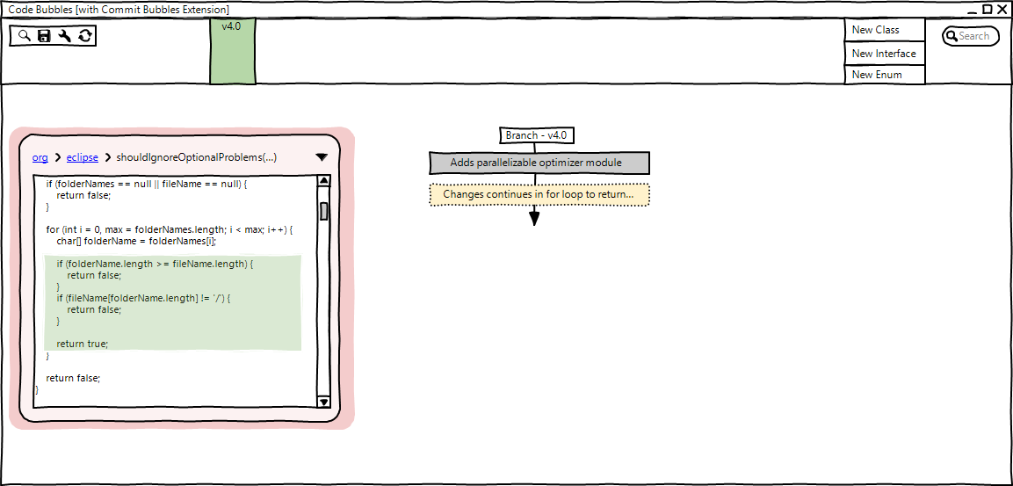
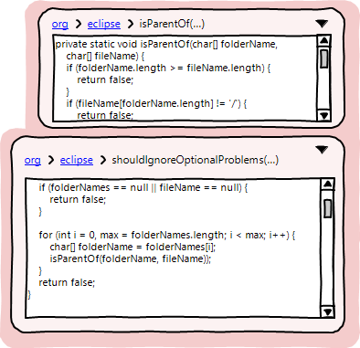
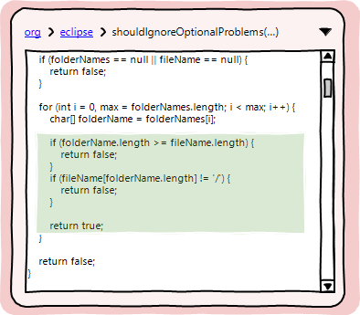
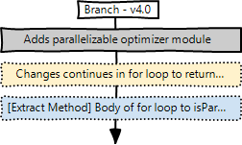
Extract Method Selection
1
2
3
Notes:
Distracted Bunch of code that’s really long and I really want to make it own method One of the problems with commit messages was that they were incomplete and failed to capture the change
Important: Automatcally captured. By blending commit activities with coding activities, version control can rather than infer, directly leverage the rich information from

Slide 16
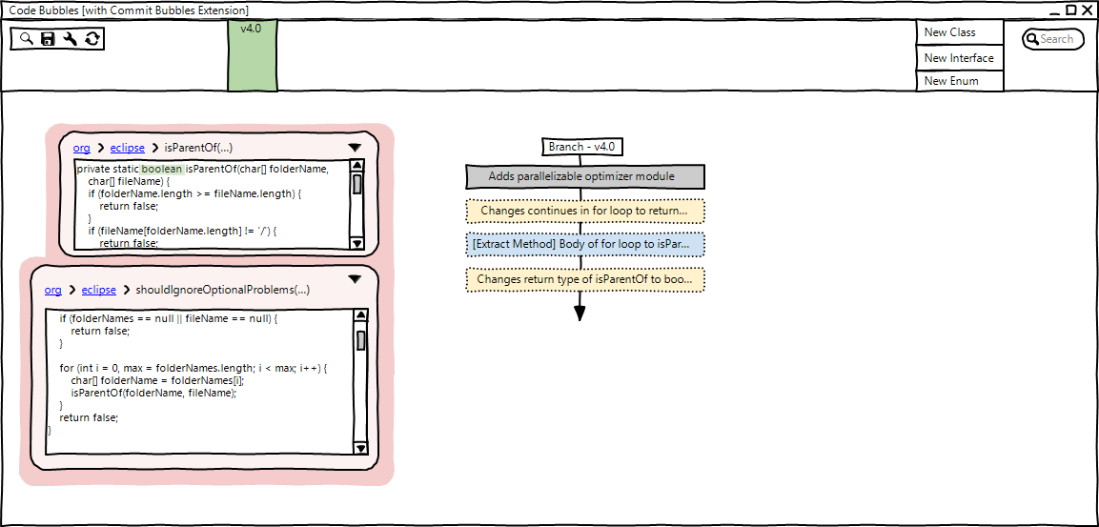
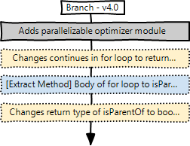
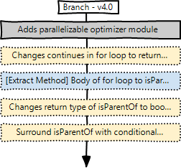
A few more fix-ups…
1
2
Notes:
… but we’re not losing information

Slide 17
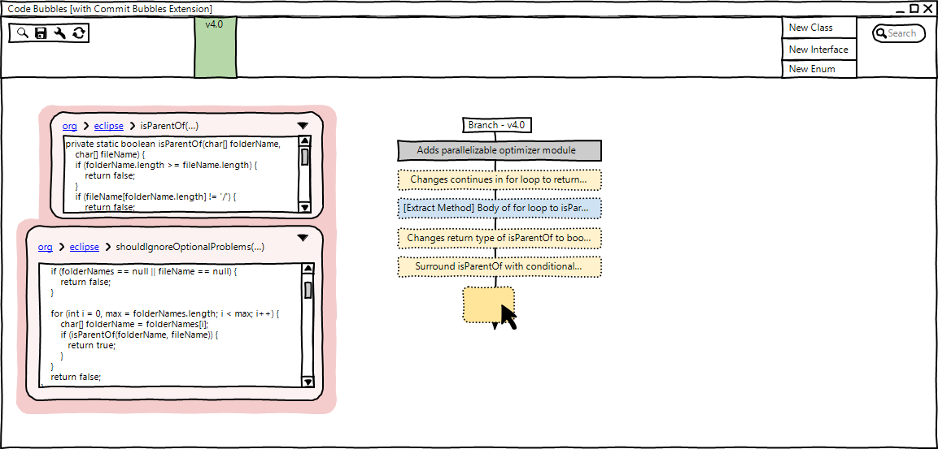
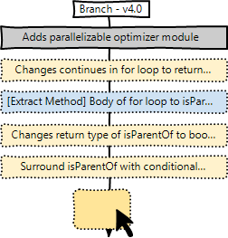
Commits Too Fine-Grained?
1
Notes:
Too fine-grained… if I had thought systematically.
But in asystem that supports history as routine

Slide 18
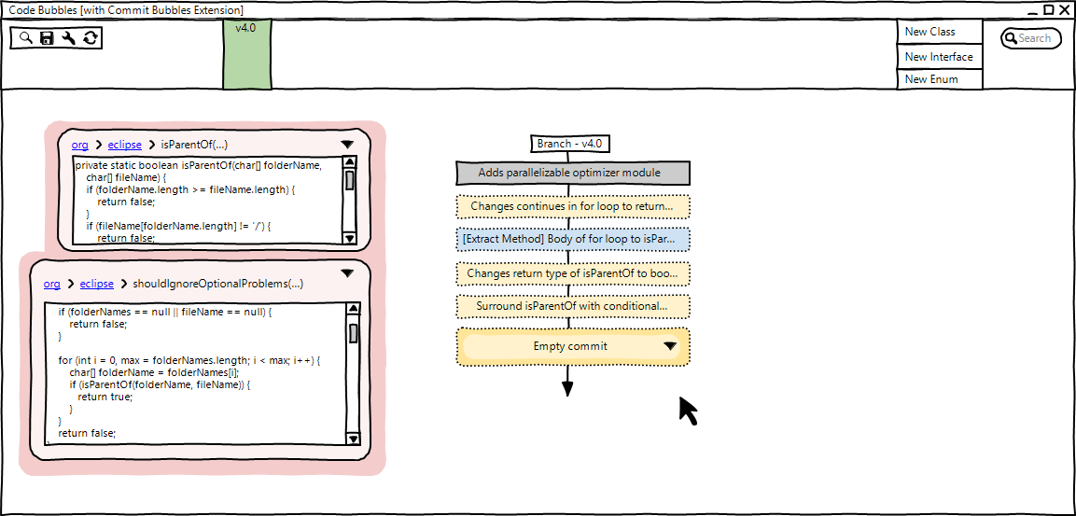
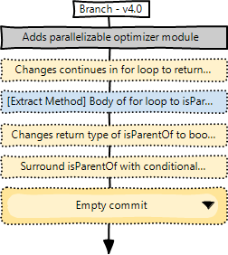
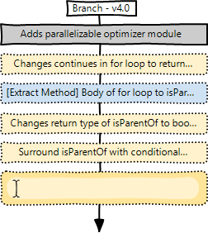
Replace Default Message…
2
3
Notes:
Git commit –amend, interactive rebase

Slide 19
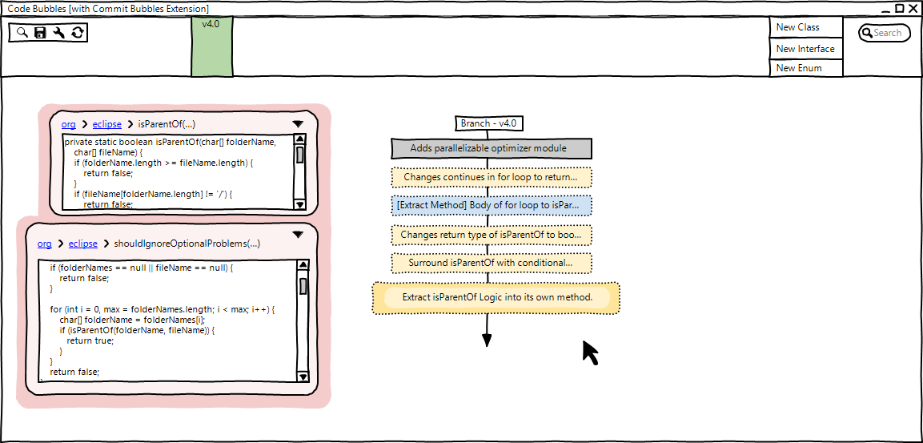
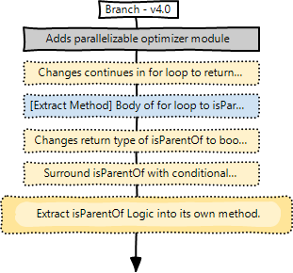
…With Descriptive Message
4

Slide 20
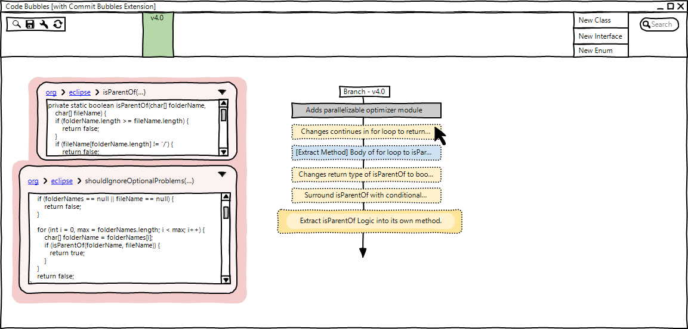
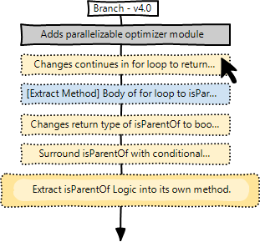
Squash Commits…
1
Notes:
Now we want to squash these commits together

Slide 21
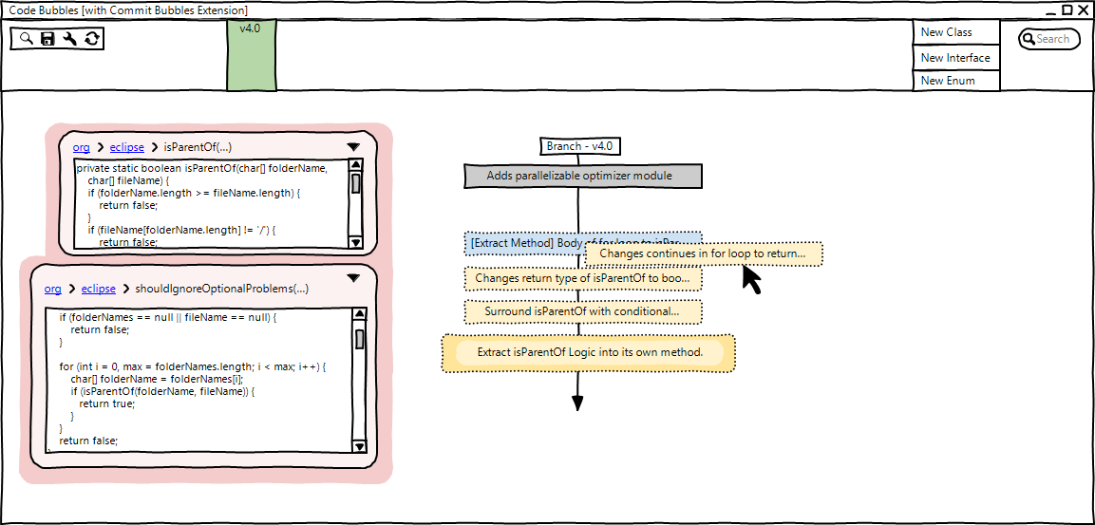
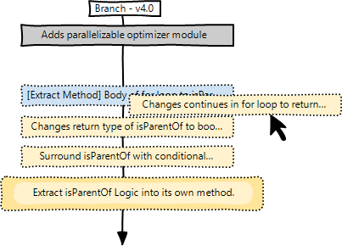
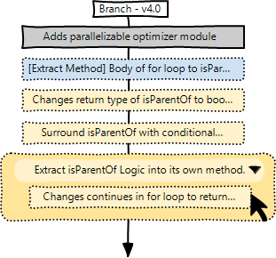
…Using Drag-and-Drop
2
3

Slide 22
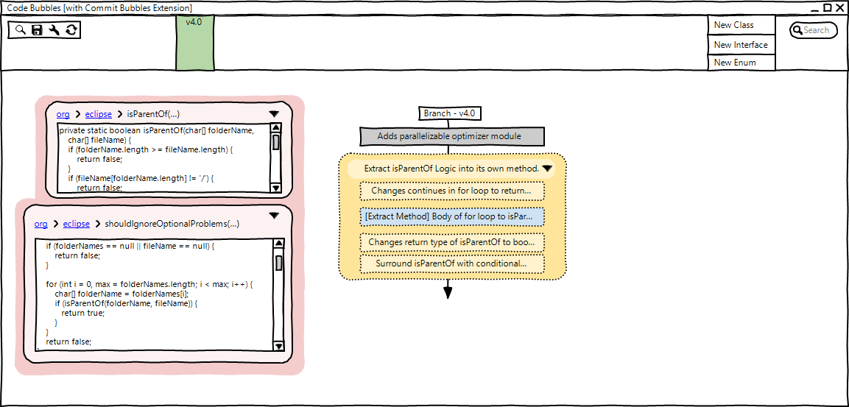
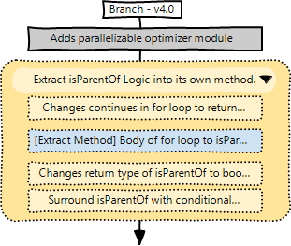
All Commits Grouped
4

Slide 23
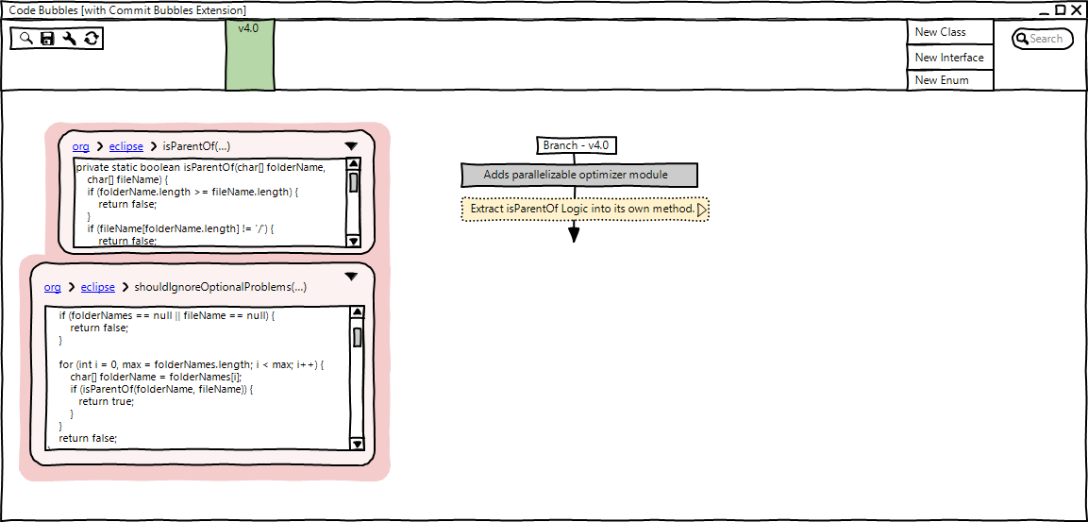
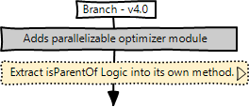
Squash the Commit
Notes:
There’s an undo. Error is routine. Reflog.
Reflog

Slide 24
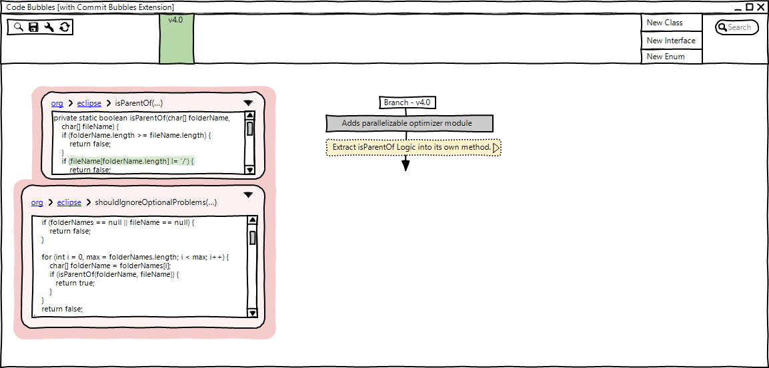
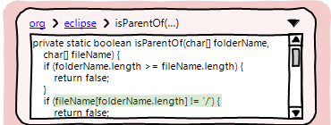
Oops, Fix the Original Issue!

Slide 25
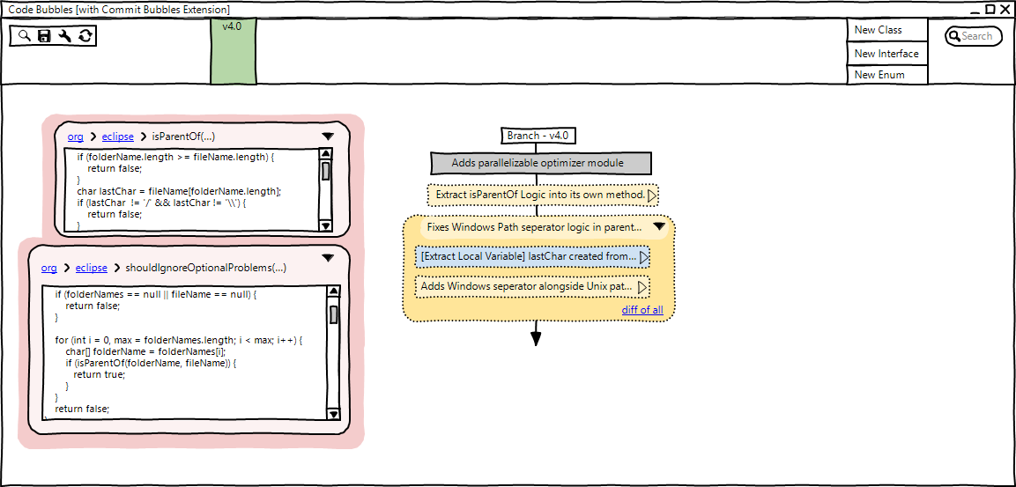
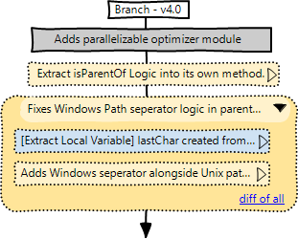
Automatic Commit Generation

Slide 26

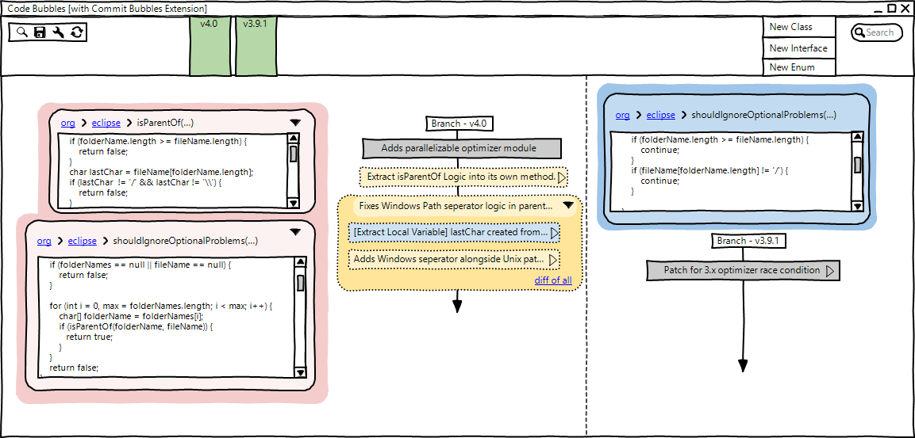
Add Task Context
1
2
Notes:
Turns out this bug is also in a past version…
Another typically obxonious operation…

Slide 27
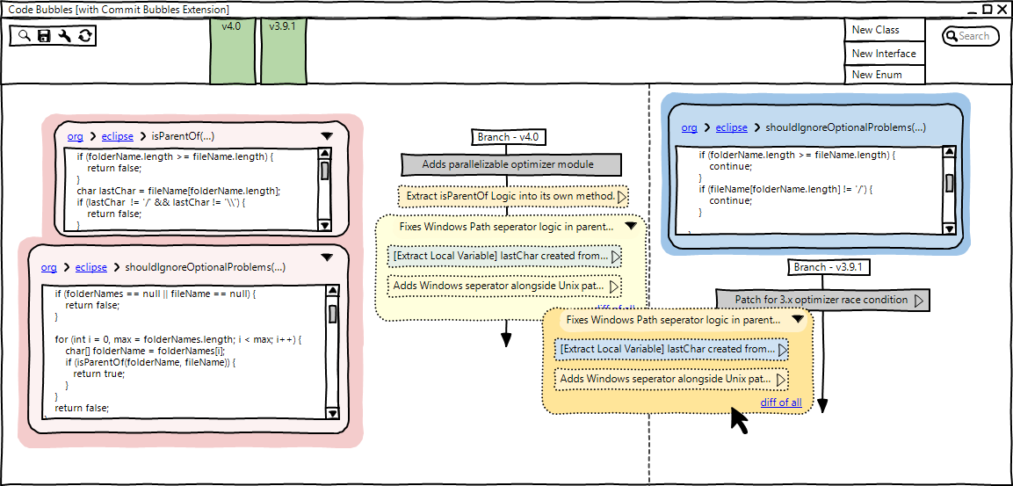
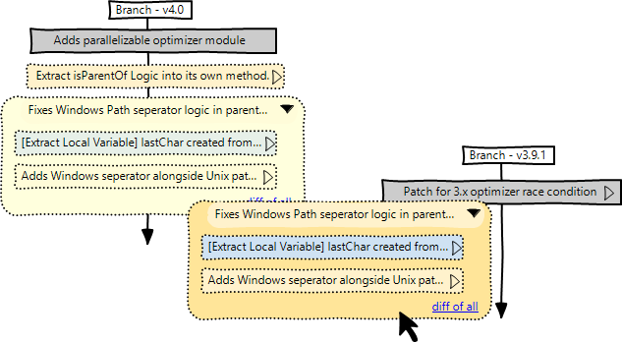
Drag-and-Drop Across Branches
1

Slide 28
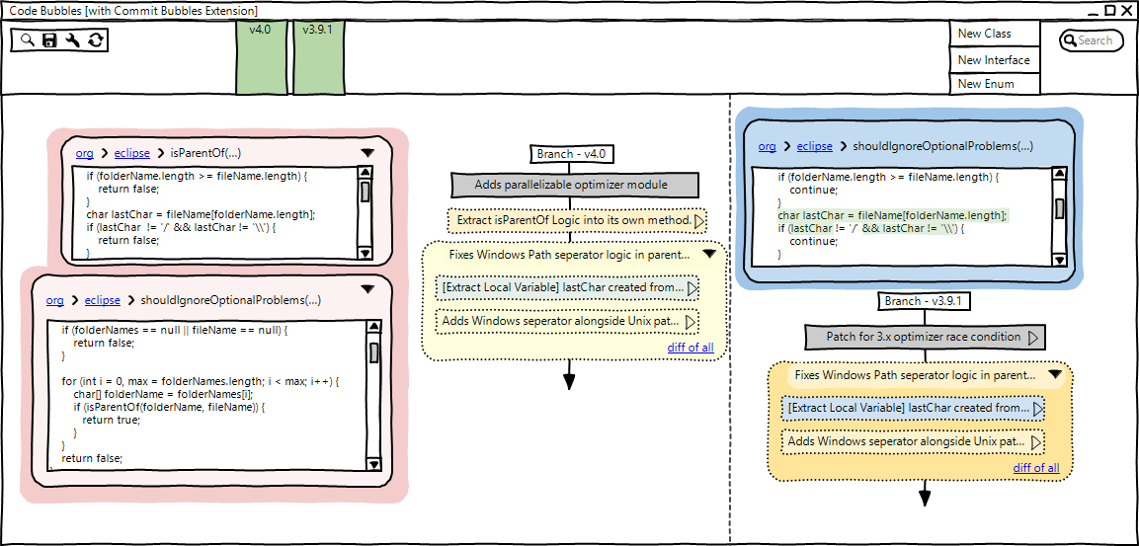
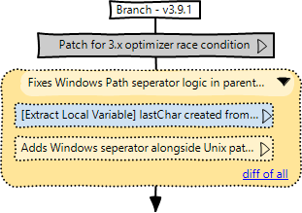
Cherry Pick Into Other Branch
2
Notes:
Works despite the fact that in the 4.0 branch, this code was added after the refactoring, but in the 3.9.1 branch still; Refactoring: when tools have this sort of context, they’re able to make more intelligent operations than what can be gleaned alone from text

Slide 29
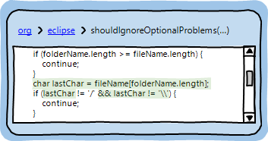
Inline Diff
Notes:
Opportunities for other tools. We can see the impact of that fix

Slide 30
Benefits
1
Automatic commits
Fast rearranging of commitments
Compare code contexts
2
3
Notes:
Somewhat contrived for time purposes
Benefits allow us to take as-needed version control histories and turn them into systematic histories…

Slide 31

Challenges
Technical
Require techniques that can automatically generate commit histories in real time. (Negara, 2012; Hayashi, 2012; Barnett, 2015; Linares-Vásquez, 2015)
Usability
Cognitive benefits to treating commits as a separate activity.
Notes:
Hand-wave, but a starting point might just be to use automatic tool operations

Slide 32
Thanks!
Our insight is that tools support systematic editing, but developers prefer as-needed workflows.
Blend coding activities with commit activities and treat exceptions as routine.
Developers can construct commit histories that adhere to best practices with less cognitive effort.
go.barik.net/icsenier2015
@barik
Notes:
Better Aligns with their own preferences and workflows

